Slide 1
Pathways to climate resilience
Shamini Harrington & louise naude
Secretariat: Dhesigen naidoo

Slide 2
Background
AR6 key messages are critically important:
The world has already warmed by 1.1 ⁰C and will temporarily reach 1.5⁰C of warming within 20 years, even in a best-case scenario of deep cuts in GHG emissions.
The changes already experienced are unprecedented in recent history and is affecting every region.
Increased droughts and fires will continue to impact livelihoods, agriculture and ecosystems across the globe.
Lack of access to productive land, water, energy and safe housing means poor communities have lower adaptive capacities and particularly vulnerable
The ability to prepare for, recover from, and adapt to these climate impacts, termed climate resilience, is what we are going to talk about!!!

Slide 3
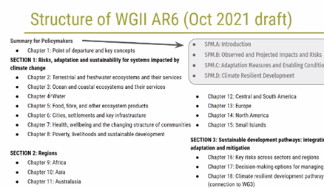
So today we will be discussing how to achieve climate resilience….
Specifically, the Commission’s role in climate resilience
  PPP – priorities, plans and positioning
We will not be discussing the impacts of climate change
The IPCC AR6 WG II ‘Impacts, Adaptation and Vulnerability’ is releasing on 28 Feb
The PCC is holding a colloquium on 3 March

Slide 4
Approach for the session
Setting the scene
Split into groups and discuss:
  Question 1: What are the priorities for climate resilience in South Africa? (10 mins)
  Discuss, record one idea and hand paper back
  Question 2: What actions should be taken to address the priorities? (10 mins)
  Discuss, record one idea and hand paper back
Reflection of ideas (15 mins)
Plenary discussion: What should the Commission do now?
Wrap up

